Slide 1
4/23/25 Status
MR Drilling
5 of 8 DDW are Operational
Pumps and Generators installed on 3 remaining wells
Working on connecting to drainage system
J&O Well Drilling
Completed 340’ Monitoring Well (Alta 9)
Added Piezometer to existing Monitoring Well (Alta 8)
Installed casing in DDW 8, next step development
Trouble shooting 3” East drainage line from WW22 to Ocean
Using East Drainage nearly doubles ACLAD system capacity
Replacing ~3000’ of drainage line with 4” above ground line

Slide 2
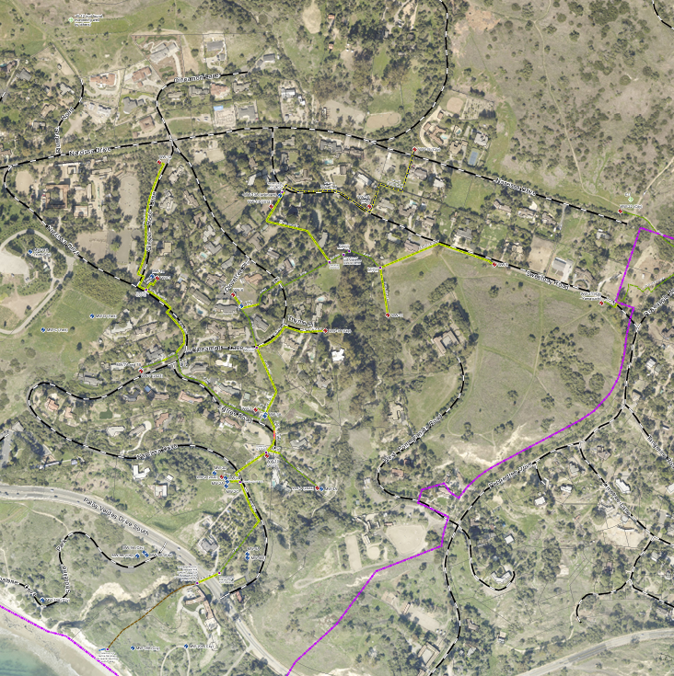
ACLAD Well Status 4.23.25
WW30
Location | DDW Well | Status | GPM | Drainage
Thyme | 27 | Operating | ~50 | W
End of Sweetbay | 21 | Pump Installed | ~40 | E
End of Narcissa | 22 | Pump and Generator Installed | ~44 | E
Petak Sweetbay | 16 | Operating | 6 GPD | E
PBRC | 25 | Operating | 24 GPD | W
38 Narccissa | 24 | Operating | ~3 | W
Barth Sweetbay | 26 | Pump and Generator Installed | ~10 | W
Parks Cinnamon | 28 | Operating | 20 | E
Mid Sweetbay | 8 | Developing |  | W
Douglas Narcissa | 29 | Planned |  | E
 | Original Wells |  | K GPD
Narcissa and Ginger Root | WW 1 | Operating | 11 | W
Figtree | WW 3 | Needs Repair | 0 | W
CloveTree | WW6 | Operating | 6
Figtree | WW10 | Operating | 3 | W
Bean Field | WW11 | Operating | 0 | E
Ginger Root | WW12 | Operating | 8 | W
Narcissa and Ginger Root | WW15 | Operating | 14 | E
Petak Sweetbay | WW16a | Operating | 6 | E
Thyme | WW17 | Replacing pump | 0 | W
Upper Cinnamon | WW 30 | Pump Installed | ~5 GPM @ 108’ | W
York | WW31 | Planned | ~ 180'x4" auger well | W
West Drainage
East Drainage
DDW29
WW15
WW12
DDW26
WW13
DDW16
DDW22
DDW25
WW1
DDW28
WW6
DDW8
DDW24
DDW27
DDW21
WW31
WW11
WW17
WW3
DDW27
WW10
WW XX - Operating Wells
- existing drainage lines
- new drainage lines
- Operating DDW
- Drilled and Finalizing
- Proposed DDW
WW18
WW20

