Slide 1
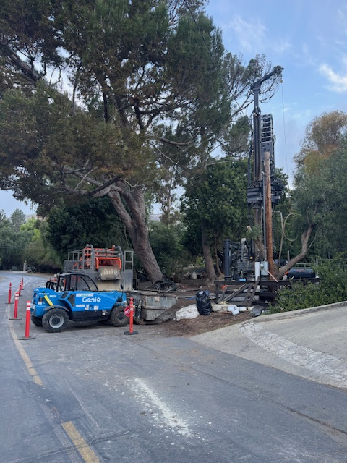
ACLAD Status 3/10/2024 Pumping 78,221 GPD
Attachments
  Surface Drainage planned Projects
  Deep Dewatering Well Plan
Maintenance
  7 wells operational on generators
  1600’ of 4” drainline replaced with flex joints
  Purchased 7 new generators (Thank you Tim Allen)
Still working out the kinks in the Trash Pump Operation
  Thanks to the Well team for going out in the rain pump
Surface Drainage projects paused to work on DDWs
FEMA Appeal
  FEMA denied Winter Storms application due to “pre-existing landslide”
  Drafting appeal with KCGHAD and RPV to submit on Friday
View looking
Down WW 4
First DDW Completed at WW 16

Slide 2
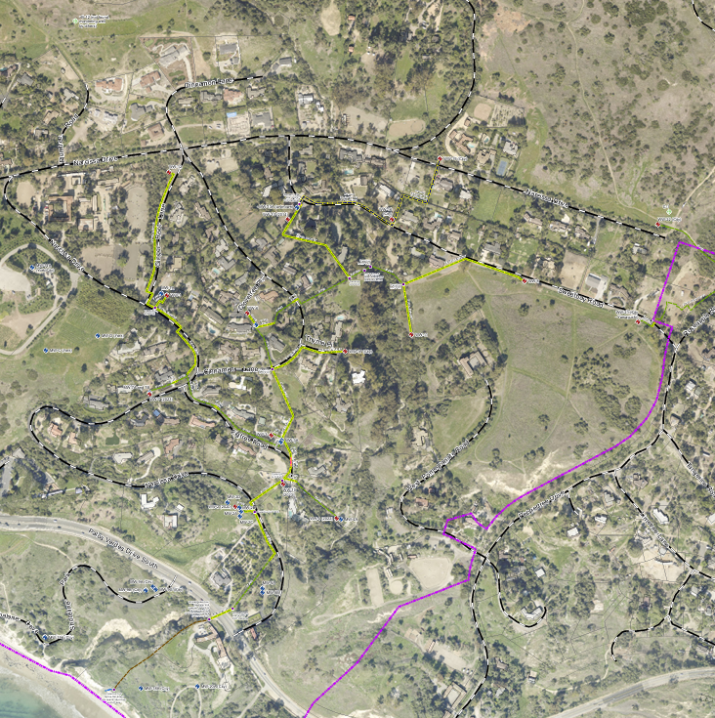
DDW Status
WW12
WW15
Drilling
  3 DDWs Drill, one pumping today
  All owner informed, easements in work
  Working to upgrade drainage system
  Adjusting well locations with drillers and property owners
WW13
WW1
WW6
WW17
WW11
WW3
WW XX - Operating Wells
- existing drainage lines
- new drainage lines
- existing DDW
- new DDW
WW18
WW20

Slide 3
Surface Drainage Projects

