Slide 1
ACLAD Operations Status
12 April 2022

Slide 2
ACLAD Summary Report April 12, 2022

Slide 3
ACLAD STATUS
CURRENTLY PUMPING 85,692 GALLONS PER DAY
Well #15 pump using timer to regulate on-times
Well #13 Pump Replaced
Control Box wiring upgraded
Failed Control Box Switch removed. Using circuit breaker for on/off switch
Inspected abandoned Well #6
Water at 87’
Casing looks good, planning to install pump to assess well output
ACLAD Near-term Plan
Schedule well drill for #4 (lower Figtree)
Investigating multiple well drilling costs
Check out pump in well #2 (lower Narcissa), gradually decreasing output

Slide 4
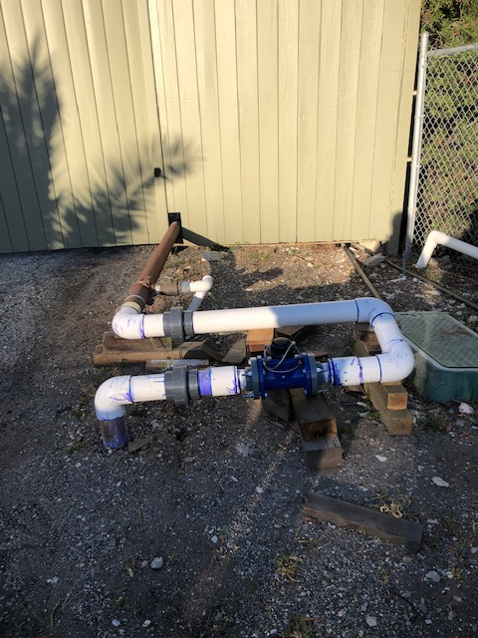
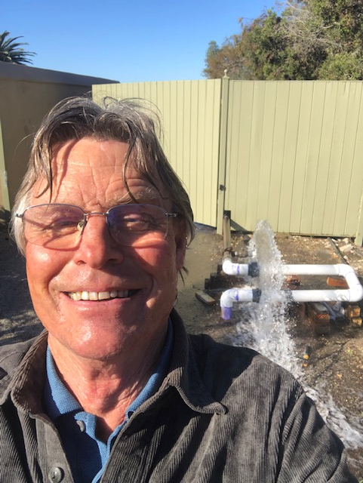
System Output Meter
Your Local Well
Technician
Leak repaired in output pipe on South side of PVDS
Appears to have been caused by land movement and lack of service loop
System output meter installed in lower leg of service loop
Recent data tracks the sum of well meters

Slide 5
Weekly Well Monitoring (gallons per day)
 | Narcissa/Gingerroot | lower Narcissa | Beanfield | upper Gingerroot | King/Sweetbay | Narcissa/Vanderlip
 | 1 | 2 | 11 | 12 | 13 | 15
1-Mar | 20,680 | 2,051 | 9,066 | 17,101 | 3,456 | 12,624
8-Mar | 17,456 | 4,944 | 11,665 | 17,227 | -5,873 | 21,340
15-Mar | 17,179 | 4,351 | 11,014 | 16,504 | 0 | 9,467
22-Mar | 19,209 | 4,140 | 11,917 | 17,343 | 0 | 14,611
29-Mar | 18,493 | 3,999 | 0 | 17,266 | 11,943 | 7,789
5-Apr | 17,631 | 4,207 | 23,840 | 17,343 | 2,888 | 11,134
12-Apr | 17,214 | 4,230 | 11,733 | 17,019 | 9,184 | 11,660
Petak/Sweetbay | Thyme | End of Narcissa | Sweetbay | Lower Figtree | Mid Sweetbay | Total GPD | PVDS Meter
16 | 17 | 19 | Yamaguchi | 3 | 8
8-Mar
15-Mar
22-Mar
29-Mar
5-Apr
12-Apr
19-Apr
8,801 | 869 | 794 | 3,494 | 3,846 | 0 | 84,564 | 0
9,519 | 857 | 580 | 3,377 | 1,563 | 0 | 74,411 | 64,275
11,954 | 851 | 157 | 3,431 | 0 | Well off | 83,613 | 76,871
9,126 | 844 | 0 | 3,453 | 0 | 0 | 72,912 | 79,686
8,264 | 857 | 0 | 3,373 | 4,303 | 0 | 86,165 | 77,743
13,804 | 849 | -1 | 11,984 | 3,799 | 0 | 85,692 | 81,757

