Slide 1
ACLAD Operations 2/12/2024
Regular Maintenance
Repaired 4 major drain line breaks due to land movement with expansion joints
R&R Well 3, 17
Fixed WW 11 main breaker
New RPV Wells
Drilled and developed wells 9, 18, 19, 20
Installed drain and electric lines to 18 and 20
WW 18 & 20 pump install this week
Working with RPV & SCE to energize wells
New ACLAD Wells
Two new wells drilled and developed
Working on drains and power
Completed PVDS Culvert repair
Meeting and Tour with LA Stormwater Engineering re: Altamira Canyon
Presentation Canyon issues at City Hall
Driving/walking tour of Altamira Canyon from ocean to upper Narcissa
CURRENTLY PUMPING ~130K GPD
Average output lower due to drain line breaks
Investigate Kelvin Canyon Spring
Flow diverted since 2019 fire hydrant break at Del Cero Park
Working with RPV Public Works to repair stream bed
Participating in Landslide Meetings
Cal Water: Tuesdays
RPV Landslide Working Group
LA Public Works for Altamira Canyon
Plans:
Start operation of 6 new wells
Work on Kelvin Spring and Altamira Canyons
WW 2 Broken drain line
WW 7 Trouble shooting
WW 3 Electrical issue
WW 21 Trouble shooting

Slide 2
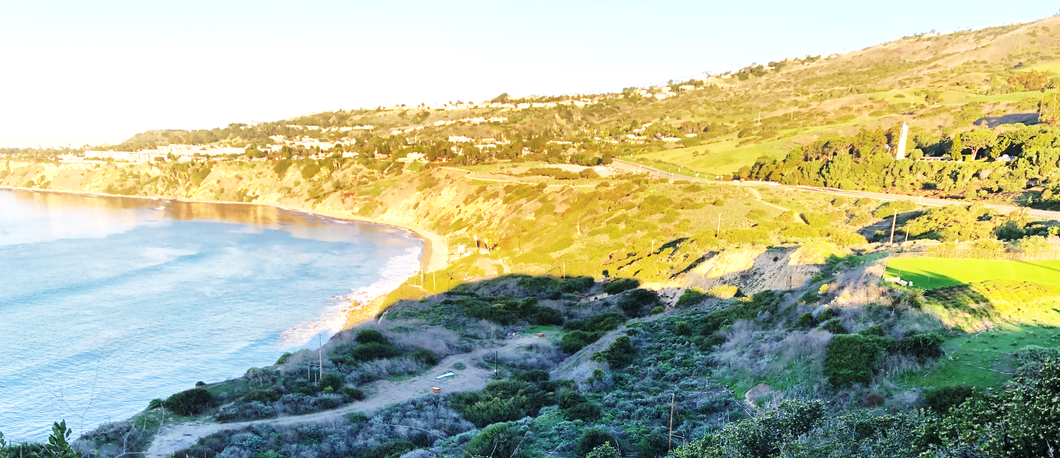
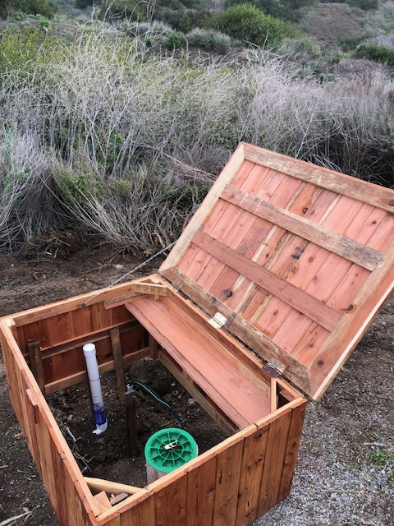
Four RPV Wells Drilled
4 RPV City Wells drilled and developed
Well 9 water depth: 114’3”
Well 18 water depth: 52’6”
Well 19 water depth: 53’
Well 20 water depth: 51’5”
Well 18 &20 drain lines and electrical complete. Coordinating with SCE for power
Installing pumps next week
Well 19 & 9 hookups in work
Monday Unloading drill rig
Well # 9
Well # 19
Well # 20
Well # 18
Sonic Mud Drilling Rig
Friday: Installing 8” PVC
Casing
Setting up on bluff

Slide 3
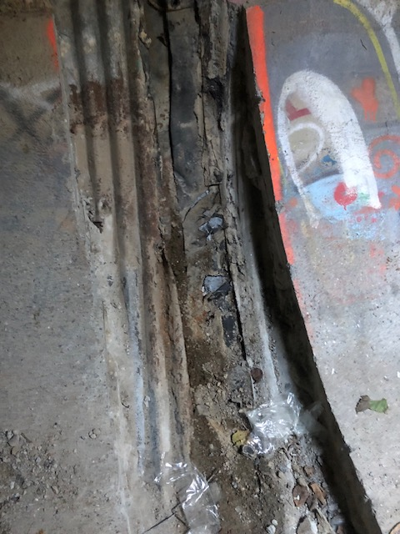
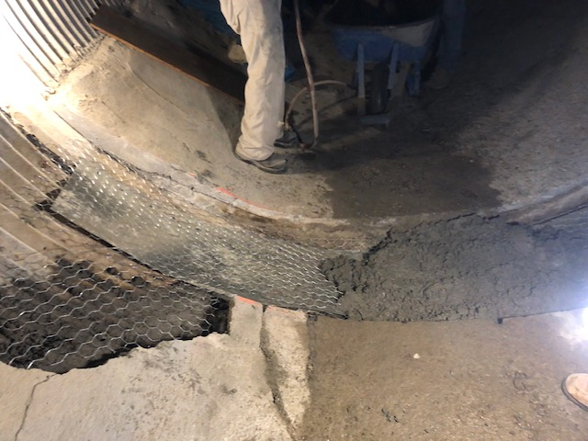
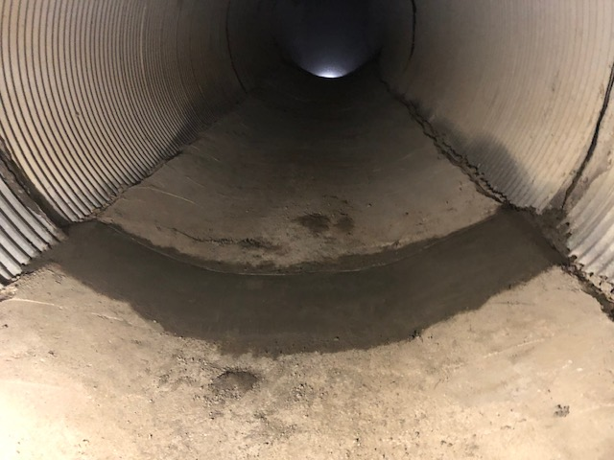
PVDS Culvert Repair Completed
Multiple cracks in PVDS Culver
Cracks range from 1” to 6” at pipe section joints
11 large cracks to be repaired with expansion joints
PVDS Culvert Repair
Remove 6” thick concrete liner at cracked joints
Install simple metal expansion joint
Replace concrete liner over joint
Broken Security
Gate & hole at
exit
Before
Expansion Joint
After
Most damage under
PVDS
Cracks at pipe joints

