Slide 1
ACLAD Summary Report March 9, 2022

Slide 2
ACLAD STATUS
CURRENTLY PUMPING 77,224 GALLONS PER DAY
Well #15 pump replaced
Fixed leak in 4” drain pipe across PVDS
Received 3” System Output Meter
Received well camera and found buckle in Well #7 at aprox 125’
Well #13 Pump? Failed last week
Well #8 (mid-sweetbay) very low flow. Turned off to diagnose cause
ACLAD Near-term Plan
  Install Output Meter across PVDS
  Replace pump in Well #7 (Narcissa by Figtree)
  Diagnose well #13 Failure
  Check out pump in well #2 (lower Narcissa), gradually decreasing output

Slide 3
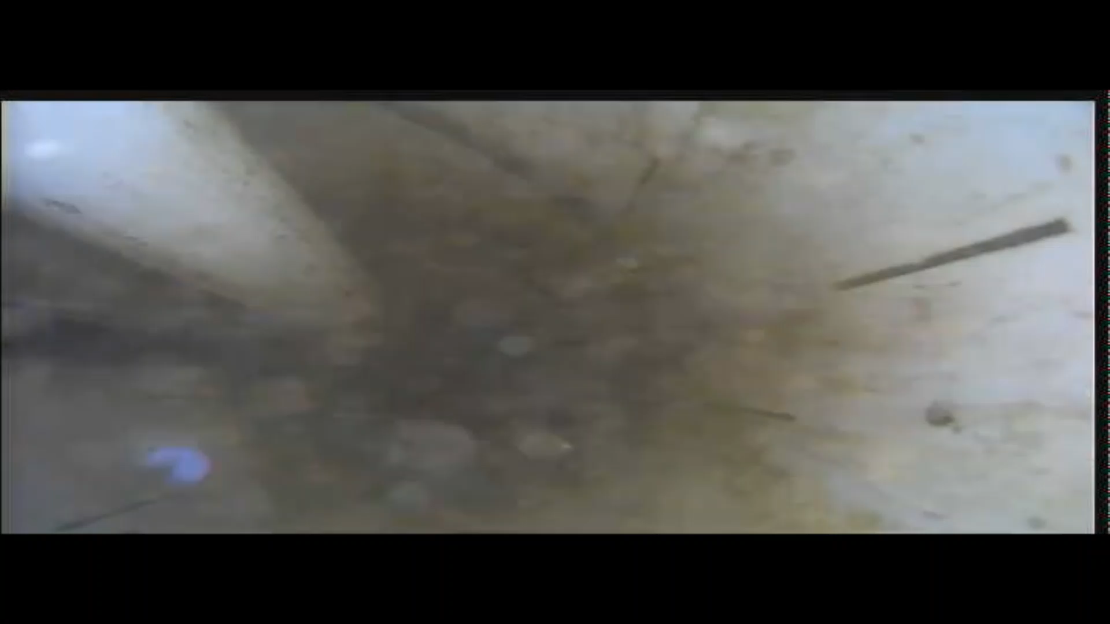
Video of Well #7

Slide 4
Weekly Well Monitoring (gallons per day)
 | Narcissa/Gingerroot | lower Narcissa | Narcissa/Figtree | Beanfield | upper Gingerroot | King/Sweetbay | Narcissa/Vanderlip
 | 1 | 2 | 7 | 11 | 12 | 13 | 15
2-Feb | 7,020 | 4,977 | 0 | 10,955 | 14,956 | 7,271 | 3,206
8-Feb | 17,153 | 5,527 | 0 | 10,805 | 20,133 | 12,960 | 15,472
15-Feb | 6,381 | 5,100 | 0 | 10,872 | 16,454 | 9,713 | 13,292
22-Feb | 0 | 5,949 | 0 | 11,199 | 15,796 | 10,106 | 0
1-Mar | 20,680 | 2,051 | 0 | 9,066 | 17,101 | 3,456 | 12,624
8-Mar | 17,456 | 4,944 | 0 | 11,665 | 17,227 | 0 | 21,340
Petak/Sweetbay | Thyme | End of Narcissa | Sweetbay | Lower Figtree | Mid Sweetbay | Total GPD
16 | 17 | 19 | Yamaguchi | 3 | 8 | Total
2-Feb
8-Feb
15-Feb
22-Feb
1-Mar
8-Mar
9,235 | 941 | 1,639 | 3,819 | 7,103 | 5,720 | 60,200
8,160 | 912 | 1,900 | 3,618 | 7,852 | 1,402 | 93,022
12,240 | 906 | 1,427 | 3,700 | 5,637 | 1,390 | 76,385
5,170 | 990 | 1,317 | 3,583 | 5,240 | 1,397 | 50,526
8,450 | 944 | 1,110 | 4,266 | 3,880 | 694 | 75,482
8,801 | 869 | 794 | 3,494 | 3,846 | 0 | 77,224

