Slide 1
6/20/2025 Status 85,000 to 100,000 GPD
11 wells are pumping 85 to 100K Gallons per Day
DDWs
  10 DDWs, 2 Monitoring Wells, and one bonus well completed
  8 of 10 Planned DDWs are Operational
    2 need final connection of East Drain line
    Early Pumping Rates variable
  DDW 16 running on hosted Solar Power
Original Wells
  5 of 12 Original Wells Operational
    2 need repair
    4 wells below PVDS need power
Added East Drain line
  3000’ of 4” drainage line installed along Sweetbay
  Attached to abandoned RPV drain line from Narcissa to Ocean
  East Drain line nearly doubles ACLAD capacity
ACLAD continues to have strong volunteer support
    Over a dozen members of the “Well Team” turn the generators on/off daily
    Several volunteers repair and change oil on generators

Slide 2
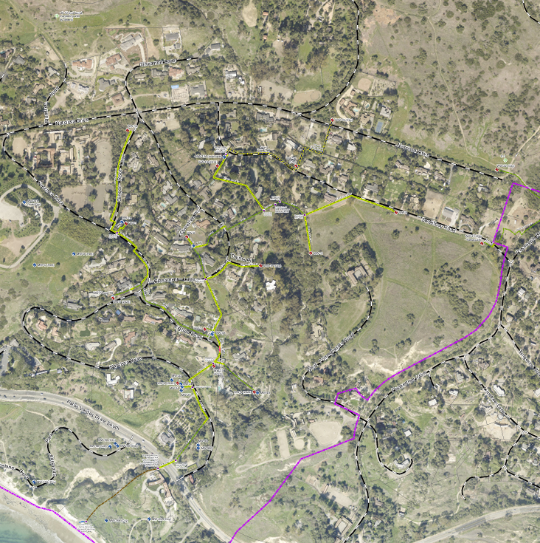
ACLAD Well Status 6.20.25
Location | DDW Well | Status | Output | Drainage
Mid Sweetbay | 8 | Drain line connect | ? | W
Petak Sweetbay | 16 | Operating | 6 KGPD | E
End of Sweetbay | 21 | Drain line connect | ? | E
End of Narcissa | 22 | Operating | ? | E
38 Narccissa | 24 | Operating | 5 KGPD | W
PBRC | 25 | Operating | 17.6 KGPD | W
Barth Sweetbay | 26 | Operating | 4.5 KGPD | W
Thyme | 27 | Operating | 11.3 KGPD | W
Parks Cinnamon | 28 | Operating | 3 KGPD | E
Douglas Narcissa | 29 | Operating | ? | E
 | Original Wells |  | K GPD
Narcissa and Ginger Root | WW 1 | Operating | 11 | W
Figtree | WW 3 | Replacing pump | 0 | W
CloveTree | WW6 | Dry | 0.2
Figtree | WW10 | Trouble shooting | 0 | W
Bean Field | WW11 | Operating | 11 | E
Ginger Root | WW12 | Operating | 7 | W
Sweetbay | WW 13 | Operating | 16
Narcissa and Ginger Root | WW15 | Operating | 15 | E
Petak Sweetbay | WW16a | Replacing pump | 0 | E
Thyme | WW17 | Replacing pump | 0 | W
Upper Cinnamon | WW 30 | Partial Shear | ~5 GPM @ 108’ | W
York | WW31 | Planned | ~ 180'x4" auger well | W
WW30
West Drainage
East Drainage
DDW29
WW15
WW12
DDW26
WW13
DDW16
DDW22
DDW25
WW1
DDW28
WW6
DDW8
DDW24
DDW27
DDW21
WW31
WW11
WW17
WW3
DDW27
WW10
WW XX - Operating Wells
- existing drainage lines
- new drainage lines
- Operating DDW
  - Drilled and Finalizing
  - Proposed DDW
WW18
WW20

