Slide 1
ACLAD Status Dec 11, 2023
Fixed drain line in Well #2
City Wells
Graded Olmstead Rd fissures
Obtained permission to use Castle water
Drilled well # 18
Started drilling Well # 20
Started repairing PVDS Culvert
Participating in Landslide Meetings
Cal Water: Tuesdays
RPV Landslide Working Group
LA Public Works for Altamira Canyon
Performing Water table measurements
Purchased ENO Sounder
Starting to install sounding tubes in wells
CURRENTLY PUMPING 169K GPD
Spreadsheet Available on website
Water Testing
PBCA resident volunteered to perform isotope testing to determine origin of water in wells
Took samples during 11/15 rain storm
Taking more samples and sending to the lab
Plans:
Replace pumps in Well # 4
Continue work on city wells and culvert and other landslide activities

Slide 2
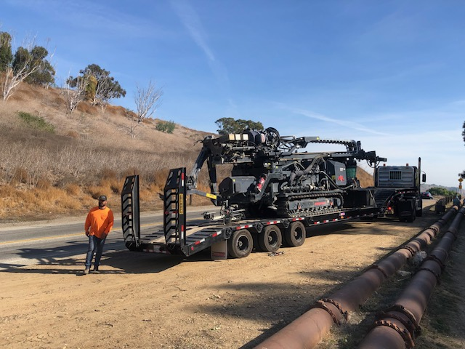
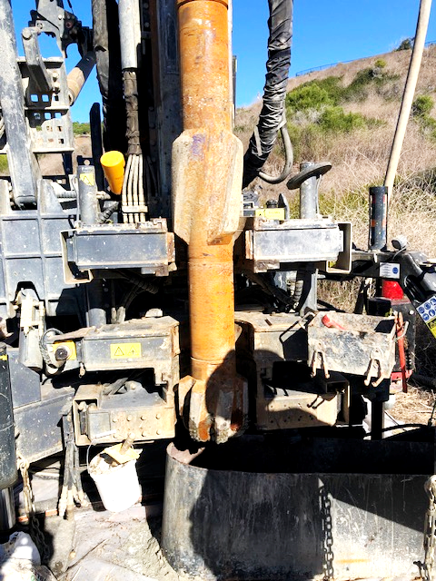
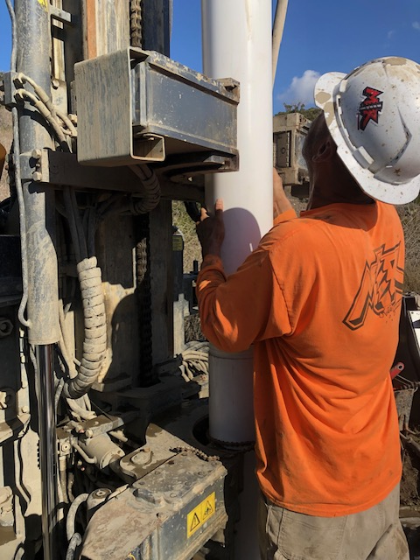
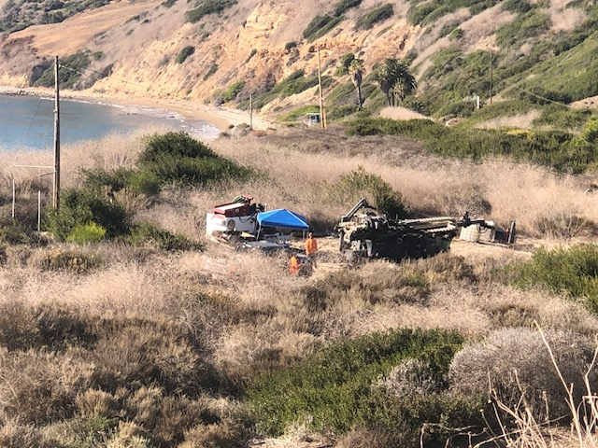
Drilling Started on PVDS Wells
Well # 18 drilled to 176’
Next Steps:
Develop Well: Bail and wash out drilling mud
Install electric, drain lines, and pump
Drill Wells 20, 19, and 9 in next 3 weeks
Monday Unloading drill rig
Setting up on bluff
Sonic Mud Drilling Rig
Friday: Installing 8” PVC
Casing
Drilling Well # 18

Slide 3
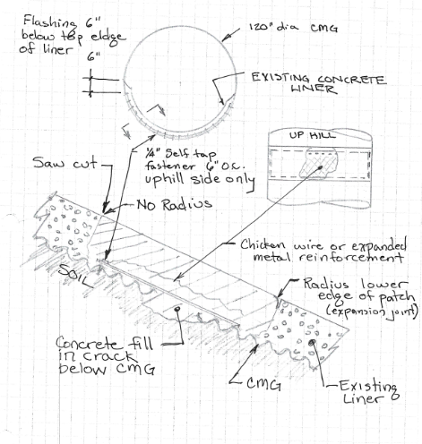
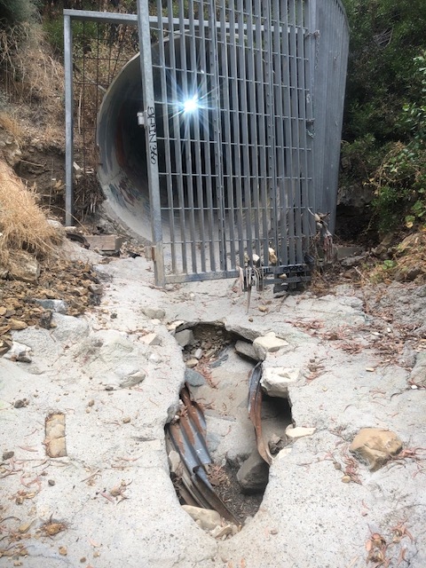
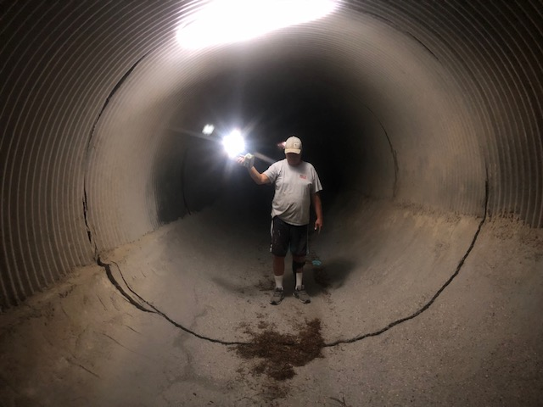
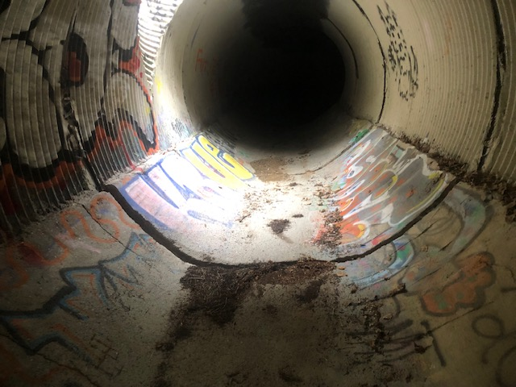
Cracks in PVDS Culvert
Expansion Joint Design
Multiple cracks in PVDS Culver
Cracks range from 1” to 6” at pipe section joints
11 large cracks to be repaired with expansion joints
PVDS Culvert Repair
City council to authorize funding on Nov 14
Repair work started 4 December
Developed design for expansion joint with rapid implementation
Contractor on board
Reviewed by Hout Engineering
Suggested adding new culver inside existing or fiberglass culvert insert
Agreed that this could not be done prior to the rains
Approved expansion design as a near term fix
Broken Security
Gate & hole at
exit
Most damage under
PVDS
Cracks at pipe joints

Slide 4
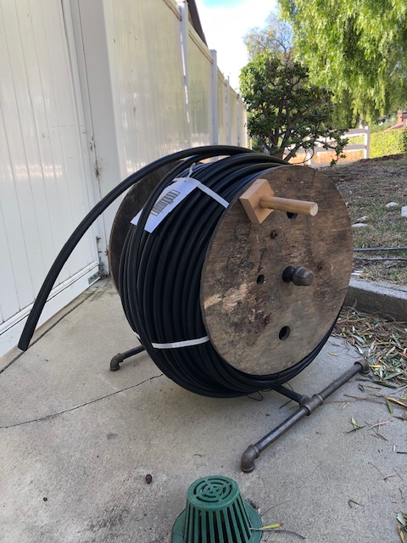
Water Level Measurement
ACLAD measures water pumping weekly
Pumping records back to 1992
Traditionally has not measured water level on regular basis
Water Measurement program started 1/2023
Measurement with Sonist water tape: difficult and time consuming
Recently purchase ENO sonic well sounder
Installing sounding tubes in existing wells
Installing permanent sounding tubes in new wells
Water Level Tape
Sonic Well Sounder
Well sounding tube

