Slide 1
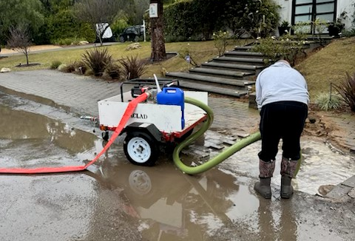
ACLAD Status 2/10/2024 Pumping 80-100K GPD
Attachments
Detailed well status
Surface Drainage planned Projects
Deep Dewatering Well Plan
Maintenance
9 wells operational on generators, 8 wells sheared
Multiple drainline breaks
Planning to replace ~1600’ with above ground 4” PVC
Generator Noise Reduction
PBCA Architectural Committee proposing guidelines
Surface Drainage highlights
Narcissa/Cinnamon Phase 1 complete, add’l 80’ planned
Vanderlip Dr. (Completed and repaired)
Figtree Cul de Sac work started
ACLAD Trash Pump, a learning process
FEMA Appeal
FEMA denied Winter Storms application due to “pre-existing landslide”
RPV hiring appeal author for joint RPV/ACLAD/KCLAD Appeal – RPV asking for $5-10K contribution
DRAFT
View looking
Down WW 4
Pumping on Ginger Root

Slide 2
Individual well status: 2/10/25 Current System Capacity ~100K GPD
WW | Location | GPD* | Comments
1 | Narcissa/Ginger Root | 13,642 | Operating on Generator
2 | Lower Narcissa |  | Sheared, pump stuck in casing, Will look into alternative pumps
3 | Figtree | 4,067 | Operating on Generator
4 | Lower Figtree |  | Sheared
6 | Clove Tree | 1,926 | Added propane shut off timer
7 | Mid Narcissa |  | Sheared
8 | Mid Sweetbay |  | Sheared
9 | Beach School |  | No Power, maybe able to power with DDW nearby.
10 | Figtree Cul de sac | 0 | No Water
11 | Bean Field | 29,877 | Operating on Generator
12 | Upper Ginger Root | 13,566 | Operating on Generator

Slide 3
Individual well status 2/10/24
WW | Location | GPD* | Comments
13 | King/Sweetbay | 16,478 | Operating on Generator
15 | Vanderlip/Narcissa | 16,761 | Operating on Generator
16 | Petak/Sweetbay | 6,949 | Operating on Generator and shallow well pump
17 | Thyme | 0 | Working on sewer generator
18 | Olmsted |  | No Power
19 | Beach School |  | No Power, may be able to power with new DDW
20 | Olmsted |  | No Power
21 | Sweetbay/Yamaguchi |  | Sheared Planning to redrill
22 | End of Narcissa |  | Need to install generator
23 | Narcissa/Altamira |  | Sheared
24 | Narcissa/Hunter |  | Sheared

Slide 4
Surface Drainage Projects

Slide 5
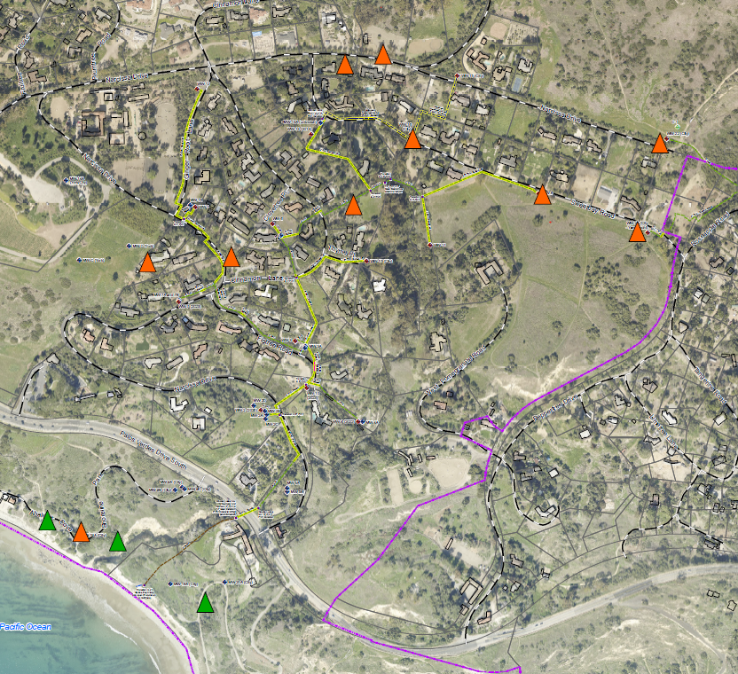
ACLAD Well System with DDW
WW12
WW15
WW13
Keep existing high performing wells
WW1, WW11, WW12, WW13, WW15
Timed operation of WW3, WW6, WW17
Add 10 Deep Dewatering Wells
Replace Sheared Wells (7)
New locations (3)
Add 2 monitoring wells
WW1
WW6
WW17
WW11
WW3
WW XX - Operating Wells
- existing drainage lines
- new drainage lines
- existing DDW
- new DDW
WW18
WW20
WW18

Slide 6
Deep Dewatering Wells

Slide 7
Average DDW Expenses include:
Site Preparation
Well Drilling
Pump Installation
Drain Line (includes upsizing to existing lines where needed)
Generator Installation
Well and Generator enclosures
Propane Installation
Clean-up
Total $140-$200K per well

