Slide 1
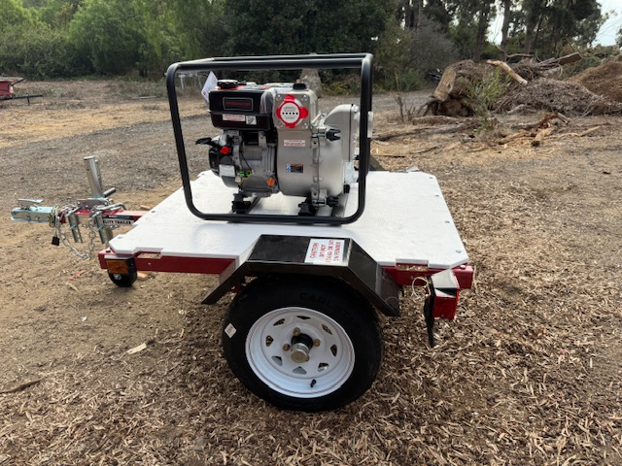
ACLAD Status 12/9/2024 Pumping 60-70K GPD
Other Activities
3 deep dewatering wells below PVDS, pumping
Application to Cal OES for fuel reimbursement
Sent Letter to SCE and CPUC to repower wells
Planning York Well (new WW 7)
Need to exercise un-powered wells
5-11 wells need solar power
Need volunteer to coordinate for ACLAD
Detailed Well Status follows
Maintenance
8 wells operational on generators, 7 wells sheared, 2 wells need various repairs
Repaired multiple drain system breaks
Reworking WW 22 and WW 11 (new pumps and generators)
Installed 3 new meters
Scheduling drilling company to fish out old drain pipe so we can add pumps above shears
Thank you to the Generator Team 9
Trash Pump and Trailer purchased (some assembly required)
Kelvin Canyon
Drains into well system
Flows thru venturi at night
Flows thru well when pumping (~5,000 GPD increase)
Need to add small electric pump to operate when well pump is on.
View looking
Down WW 4

Slide 2
Individual well status: 12/9/24 Current System Capacity 60-70K GPD
WW | Location | GPD* | Comments
1 | Narcissa/Ginger Root | 12,000 | Operating on Generator
2 | Lower Narcissa |  | Sheared, pump stuck in casing, Will look into alternative pumps
3 | Figtree | 3,300 | Operating on Generator
4 | Lower Figtree |  | Sheared
6 | Clove Tree | 3,000 | Operating on Generator
7 | Mid Narcissa |  | Sheared
8 | Mid Sweetbay |  | Sheared
9 | Beach School |  | No Power, maybe able to power with DDW nearby.
10 | Figtree Cul de sac | 0 | Replaced meter, Needs new pump
11 | Bean Field |  | No Power, may be sheared. Pulling pump
12 | Upper Ginger Root | 5,800 | Operating on Generator

Slide 3
Individual well status 10/14/24
WW | Location | GPD* | Comments
13 | King/Sweetbay | 4,000 | Operating on Generator
15 | Vanderlip/Narcissa | 5,000 | Operating on Generator
16 | Petak/Sweetbay | 1,000 | Operating on Generator and shallow well pump
17 | Thyme | 2,000 | Working on sewer generator
18 | Olmsted |  | No Power
19 | Beach School |  | No Power, may be able to power with new DDW
20 | Olmsted |  | No Power
21 | Sweetbay/Yamaguchi |  | Sheared Planning to redrill
22 | End of Narcissa |  | Need to install generator
23 | Narcissa/Altamira |  | Sheared
24 | Narcissa/Hunter |  | Sheared

Slide 4
Surface Drainage
Status
Upper Altamira Canyon Lined
Kelvin Canyon Graded
Narcissa at PBRC (Completed)
Narcissa/Cinnamon (24” complete, 12” Cinnamon line in work)
High priority drainage projects:
Upper Narcissa to Ginger Root $10K (100’ above ground connector culvert)
Figtree cul de sac $43K (recommend $ 20K modification)
Narcissa Curve Drainage $10K (4” drain line option)
Vanderlip Dr. $40K ???
Lower Ginger Root to Narcissa $5K (trench around corner)

Slide 5
Project: Upper Narcissa to Ginger Root
Re-locate existing culvert to drain Narcissa near 5 corners on to lower portion of culvert to Ginger Root
Current alignment traverses ACL boundary fissure
Create drain from Ginger Root to Narcissa over fissure
Small lined swale
Above ground 12” corrugated pipe and catch basin
Approximate cost: $10K est.

Slide 6
Project: Figtree Cul de Sac
Nearly all of PBCA stormwater goes through Figtree to Altamira Canyon
Ocean side of cul de sac subsided and water does not flow to culvert
Regrade Figtree cul de sac to direct stormwater into the culvert (ACLAD Drainage)
Repave cul-de-sac (PBCA Roads)
Approximate cost: $42.6K
Still looking into options

Slide 7
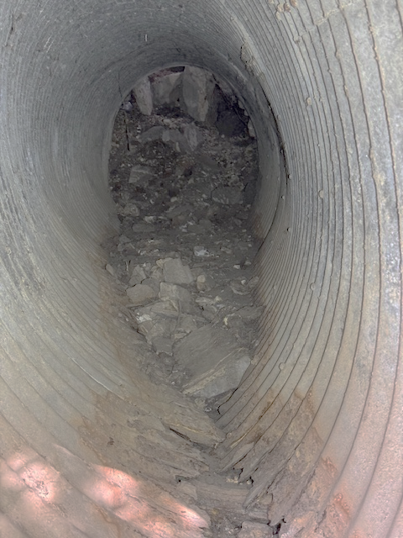
Project: Vanderlip Culvert at Kelvin Canyon
Fissure at Narcissa Curve created depression which will not allow stormwater to flow to drains on lower Narcissa
Replace 80’ x 42” dia culvert
Grade roadside swale
Will work with owners for cost/share
Approximate Cost: $40K estimate

Slide 8
Project: Narcissa Curve
Fissure through Narcissa Curve collects storm water in depression
Alternative solutions
Site assessment with Kelly, Zelhart, Leon, Chiles
4” Drain under road to hillside ($20K est)
1,000’ 4” drainline to keep water on Narcissa and away from Wayfarer’s Chapel
Too soon to predict stability of Narcissa Curve
4” drain line inexpensive and amenable to modification ($10K est)

Slide 9
Board Approvals Required
Figtree cul de sac $43K
Upper Narcissa to Ginger Root $10K
Narcissa Curve $10K
Vanderlip Dr $40K

