Slide 1
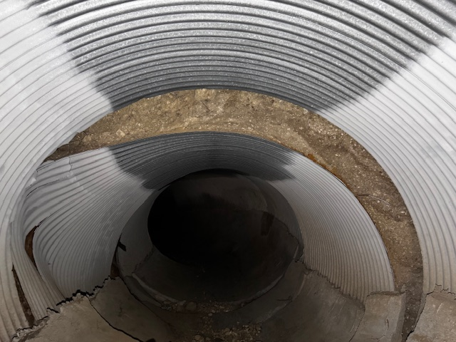
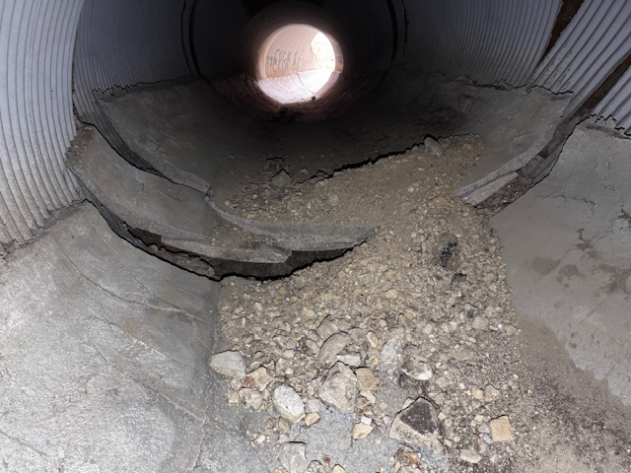
9/9/2025 System Status
  Replaced and Repaired Multiple Generator
  Repaired Several line breaks
  Running wells 12 and 25 from diesel generator
    Working with SCE to power these wells
  DDW City Loan remaining balance: $140,000?
    Remaining DDW Tasks:
      Well Boxes
      Noise Proofing Generators
      Connect WW11, WW16, WW15, DDW29 to East Drain line
      Spare Drain line flex hoses
      One additional well

Slide 2
Surface Water Control DRAFT
  Winterization Projects:
    Altamira 10’ Dia Culvert Repair ($100K NTE T&M )
      Coordinating design/contracting with RPV
      RFPs to 3 contractors
      Tim Conners (Hout Professional Engr) to manage project
      Proposed RPV/ACLAD cost share similar to 2024 work
      RPV wants ACLAD to manage/fund contracting due to lower cost structure
      Need motion to approve plan to RPV City Council (Sept 16) and NTE of $50K from ACLAD
    Lower Altamira Canyon, land movement blocked drainage
      Grade end of canyon to provide drainage to the ocean
      Coordinating design/contracting with RPV
      Tim Conners to manage project
      Proposed RPV funding of work on City land
      RPV wants ACLAD to manage/fund contracting
      Need motion to approve plan to RPV City Council (Sept 16)
    Need to submit ACLAD proposals Sept 9 for inclusion in CC staff report

Slide 3
Surface Water Control DRAFT
    Winterization Projects:
      Figtree Cul de sac
        Grade change and re-pave
        Design in work
        Propose ACLAD/PBCA cost share
        Finalize and approve at October ACLAD mtg
      Lower Cinnamon drainage $13K
        Extend 12” culvert extension
        Need motion to approve with NTE of $13K
      PBRC and Ginger Root Drain line to Narcissa/Cinnamon Culvert ~$10K
        Land movement prohibits long term solutions
        ACLAD to rent large diesel pump located on Narcissa next to PBRC cistern
        Install 4” PVC drain line along Ginger Root and Narcissa to Cinnamon drain
        Need motion to approve with NTE of $15K
      Upper Narcissa to Ginger Root and Sweetbay Lake drains ~$10K
        Install 6” corrugated flex plus box
        Need motion to approve with NTE of $15K

Slide 4
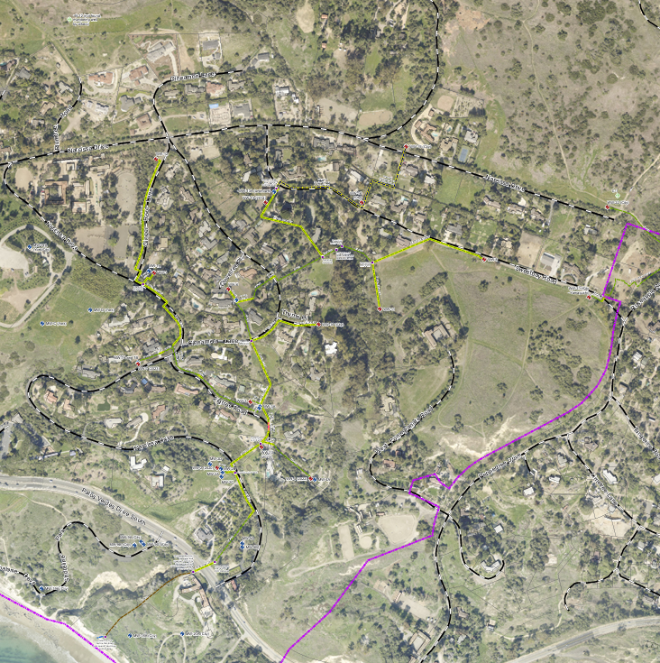
WW30
West Drainage
East Drainage
DDW29
WW15
WW12
DDW26
WW13
DDW16
DDW22
DDW25
WW1
DDW28
WW6
DDW8
DDW24
DDW27
DDW21
WW31
WW11
WW17
WW3
WW10
WW XX - Operating Wells
- existing drainage lines
- new drainage lines
- Operating DDW
- Drilled and Finalizing
- Proposed DDW
WW18
WW20

