Slide 1
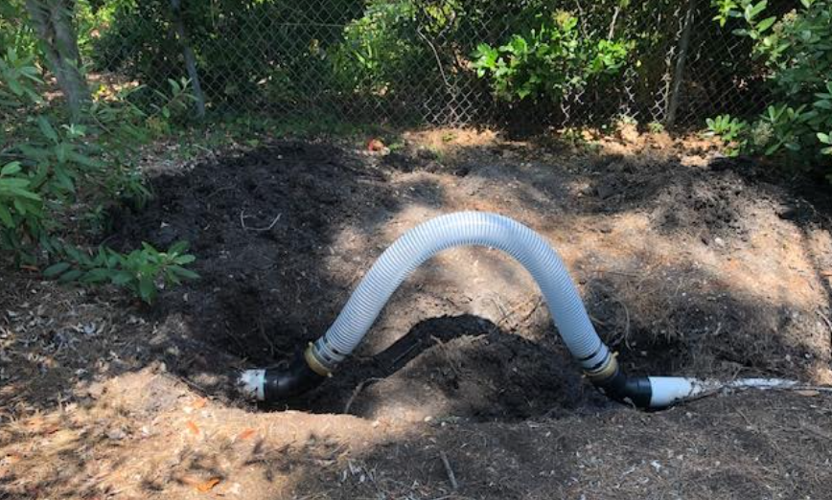
ACLAD Status 8/12/2024
CURRENTLY PUMPING 49,441 GPD
Combination of multiple system breaks and lower pumping rates
Maintenance
10 wells operational, 6 wells sheared, 6 wells need various repairs
Repaired multiple system drain pipe breaks
Re-route 4” system drain over new Cal Water pipe
Replace clogged meters
New box on WW2
R&R WW 16,
Removed stinky dead opossum with babies
Routed plumbing around failed boost pump
Developed replaceable flex joint design for 4” pipe
Other Activities
Coordinating new wells with MR Drilling
RPV Coordination meetings
FEMA coordination for 1/31-2/9 Storm 4769
Tour with FEMA Reps of Damage sites
RPV Fast Track Loan: $1.61M
Interviewed New Clerk applicants
Detailed well status follows
View looking
Down WW 4

Slide 2
Individual well status: 7/2/24
WW | Location | GPM | Comments
1 | Narcissa/Ginger Root | 0 | Investigating
2 | Lower Narcissa | 0 | Need to replace pump
3 | Figtree | 0 | Need to replace pump
4 | Lower Figtree | 0 | Sheared
6 | Clove Tree | 2,857 | Old well working, Need to remove plumbing from new well
7 | Mid Narcissa | 0 | Sheared
8 | Mid Sweetbay | 0 | Sheared
9 | Beach School | 0 | Looking into drainage restriction
10 | Figtree Cul de sac | 2,975
11 | Bean Field | 13,035 | R&R, dead opossum in well
12 | Upper Ginger Root | 12,000 | Meter replaced

Slide 3
Individual well status
WW | Location | GPM | Comments
13 | King/Sweetbay | 4,320
15 | Vanderlip/Narcissa | 8,275
16 | Petak/Sweetbay | 0 | Sheared Water level 26’. Installing surface pump
17 | Thyme | 0 | Replacing pump this week
18 | Olmsted | 6,134
19 | Beach School | 4,119
20 | Olmsted | 4,181
21 | Sweetbay/Yamaguchi | 0 | Sheared Planning to redrill
22 | End of Narcissa | 0 | Drainline damaged, investigating pump,
23 | Narcissa/Altamira | 0 | Sheared
24 | Narcissa/Hunter | 4,650

Slide 4
Kelvin Canyon Spring
Kelvin Canyon Spring
Canyon seeps aprox 15 GPM
Capturing spring water roughly equivalent to a new well
Progress to date
City cleared canyon to the spring and purchased 2400’ of corrugated drain line
Volunteers installed Weir, Drain line and sump by WW 15
Needed to complete
Fix break in underground line at Vanderlip Rd
Create debris filter
Install bypass valve to “turn off” spring
Add electrical outlet and input drain at WW15
Cost
Less than $1000 to complete
Total cost to ACLAD: less than $2000 + city work

Slide 5
ACLAD Fast Track Projects
System Improvements |  |  | $K Cost Est
 | 1 | Six new de-watering wells (+2 wells in ACLAD Budget) | $750
 | 2 | Modify existing drainage system to add expansion joints at fissure locations and extended straight lengths | $150
 | 3 | Well Repairs and system optimization | $100
 |  |  | $1,000
Surface Drainage
 | 4 | Develop detailed conceptual plan and coordinate with gov't agencies to obtain BRIC or ACOE grants | $100
 | 5 | Line Altamira Canyon from Figtree drain to PVDS culvert | $150
 | 6
 | 7 | Improve drainage along Narcissa from the PBRC fissure to Narcissa and Ginger Root | $50
 | 8 | Improve drainage from Narcissa and lower Cinnamon to culvert | $45
 | 9 | Replace swale across the corner of the riding club between Upper Narcissa and Ginger Root | $65
 | 10 | Add curbing to Upper Cinnamon | $5
 | 11 | Modify drainage from Lower Cinnamon through Ride-to-fly and the adjacent lots | $50
 | 12 | Add curb to lower Vanderlip Dr and bridge stormwater across 3 major fissures on Upper Vanderlip Dr | $40
 | 13 | Repair and replace the deep swale along figtree to direct the stormwater flow to the culvert | $80
 | 14 | Lengthen Thyme Swale into Altamira Canyon | $20
 | 15 | Add Curbing around 30 Narcissa | $5
 |  |  | $610
Total |  |  | $1,610
All projects to be vetted with GeoTech and RPV for landslide mitigation

Slide 6
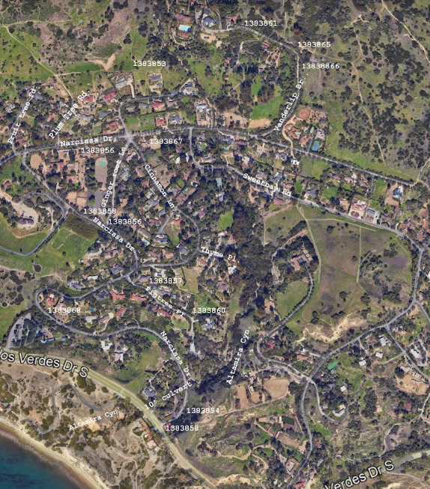
Surface Drainage Projects
Funded by RPV loan to ACLAD
Applied for FEMA grants for same Projects
Working with engineer to define the appropriate designs

Slide 7
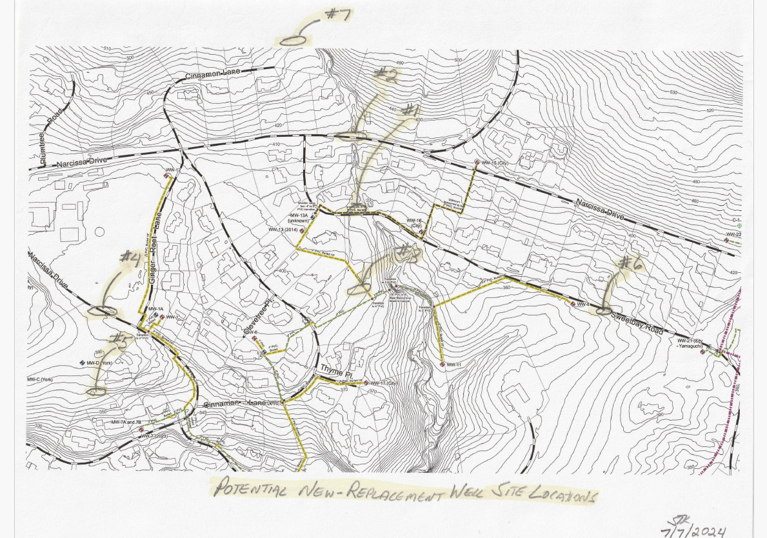
Potential New Well Locations

