Slide 1
10/13/2025 System Status
  Replaced and Repaired Multiple Generators
  Repaired Several line breaks
  Running wells 11,12,29 from diesel generators
    Working with SCE to power these wells
  DDW City Loan remaining balance: ~$125K
    Remaining DDW Tasks:
      Well Boxes Completed
      Noise Proofing Generators and changing to Kubota Diesels (3 operating)
      Connect WW11, WW16, WW15, DDW29 to East Drain line
      Spare Drain line flex hoses
      One additional well

Slide 2
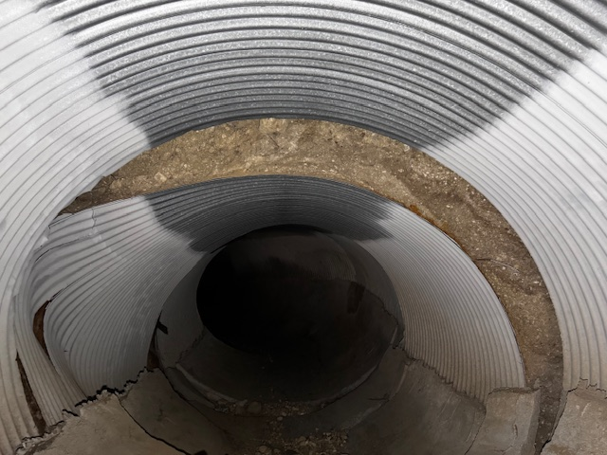
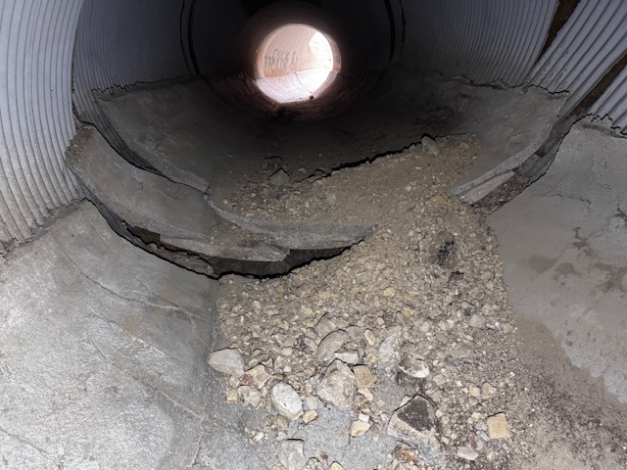
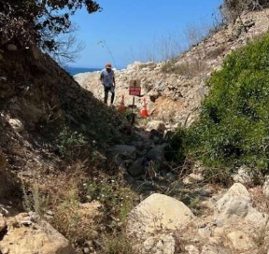
Surface Water Control
  Winterization Projects:
    Altamira 10’ Dia Culvert Repair ($100K NTE T&M )
      Coordinating design/contracting with RPV
      Colich Engineering to start soon
      Tim Conners (Hout Professional Engr) to manage project
      Project Plan
        Exposed and remove damaged pipe
        Install open section of pipe as “floor”
        Concrete line bottom of pipe
        Cap open pipe with removable section
        Fence and leave pipe exposed for future repair (temporary)
      NTE $100 K $50K ACLAD, $50K RPV
    Lower Altamira Canyon, land movement blocked drainage
      Grade end of canyon to provide drainage to the ocean
      Drews Company bid $98K, starting soon
      Tim Conners to manage project
      RPV CC funding

Slide 3
Surface Water Control
    Winterization Projects:
      Figtree Cul de sac
        Grade change and re-pave
        Getting estimate from CSI
        Propose ACLAD/PBCA cost share
        Discuss approval by NTE, Special Meeting, or Nov. Board Mtg?
      Completed Lower Cinnamon drainage $13K
      PBRC and Ginger Root Drain line to Narcissa/Cinnamon Culvert ~$15K
        Planning phase
      Upper Narcissa to Ginger Root and Denver Lake drains and Sweetbay lake ~$20K
        Planning Phase
      Narcissa Curved Drainage
        Matt and City met to work design

Slide 4
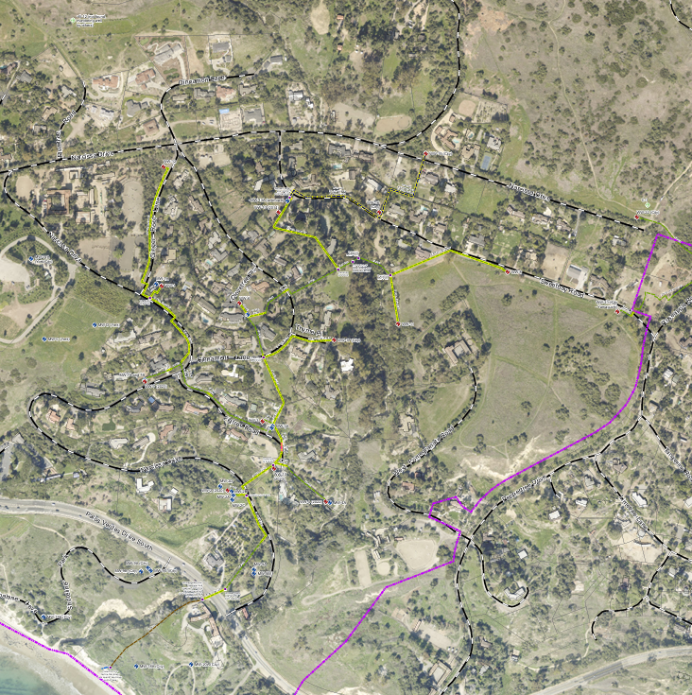
WW30
West Drainage
East Drainage
DDW29
WW15
WW12
DDW26
WW13
DDW16
DDW22
DDW25
WW1
DDW28
WW6
DDW8
DDW24
DDW27
DDW21
WW31
WW11
WW17
WW3
WW10
WW XX - Operating Wells
- existing drainage lines
- new drainage lines
- Operating DDW
- Drilled and Finalizing
- Proposed DDW
WW18
WW20

