Slide 1
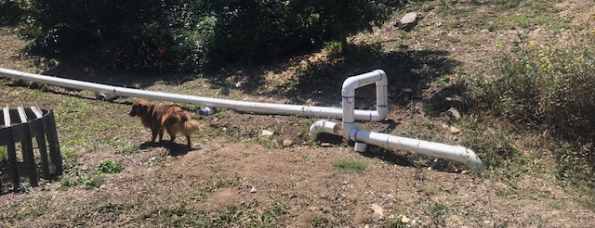
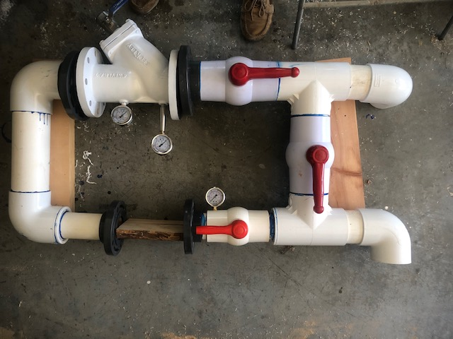
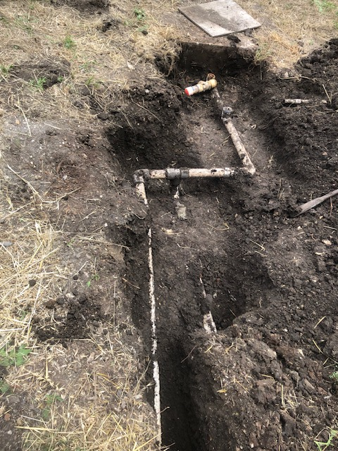
WELL STATUS June 12, 2023
CURRENTLY PUMPING 113,000 GALLONS PER DAY
Repaired 6” system drain line in Gate Park
Line placed above ground
Ordered 6” unions for land movement
PVDS System Bipass, Y Filter, Meter assembled
Repaired and moved 2” drainlines for wells 1 and 7 outside building setbacks
Dimensioned for inclusion in drainage map
Planned
Replace pump in well #3 (Figtree)
Replace pump in well #4 (Clovetree)
Add meter to well #6 (Covetree)
Install System bypass
Apply for Permit for electrical on Well # 10

