Slide 1
WELL STATUS Dec 13, 2022
CURRENTLY PUMPING 73,000 GALLONS PER DAY
Well # 6 (Clovetree)
  SCE says permit issues are resolved, meter install in 2-3 weeks
Well #18 (near ocean)
  Non-operational after test with portable generator
  Well sheared and pump is stuck in well
Well #13
  Remove and replace pump
Well #2 (lower Narcissa)
  Remove and replace pump
  Need to add Pumptek or timer
ACLAD Near-term Plan
  Clean debris from PVDS system meter
  Get Bids for 1-3 Wells

Slide 2
ACLAD Summary Report Sept 13, 2022

Slide 3
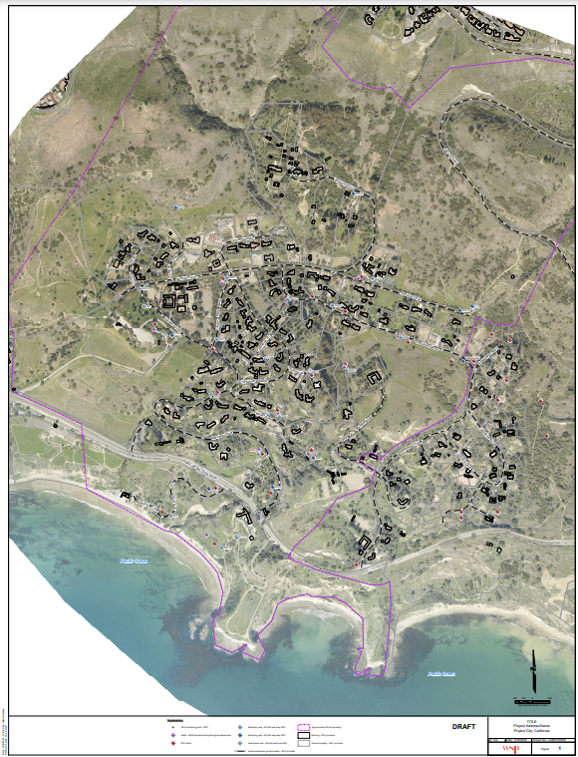
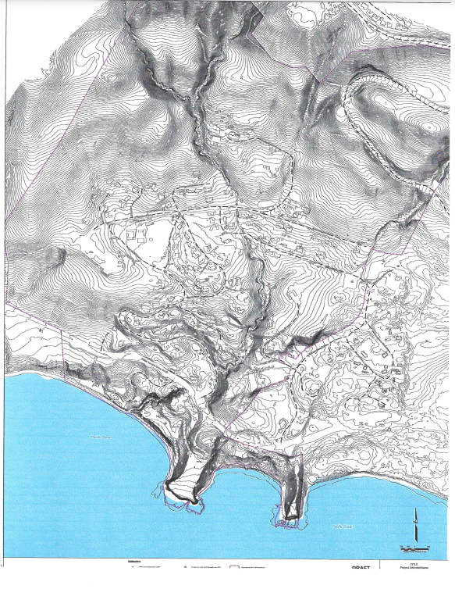
ACLAD Well Maps and DataBase
Updated map and data base in work
GIS map of wells and topo contours
Excel spreadsheet summarizing all well data
Plan for water level measurement

