Slide 1
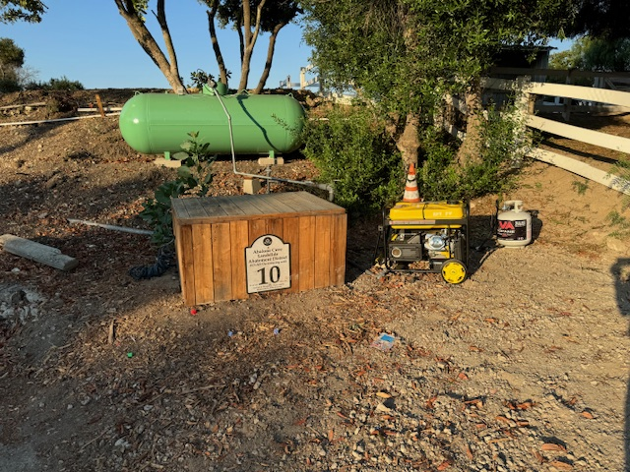
ACLAD Status 9/9/2024
Other Activities
Pause in new wells till we define power plan
RPV drilling 5 bore holes in ACL to assess Altamira slip surface
Submitted final Damage Inventory to FEMA
Detailed well status follows
Too soon to know pumping volume on propane generators
Maintenance
10 wells operational on generators, 7 wells sheared, 5-11 wells need solar power, 2 wells need various repairs
Installed 9 Generators
Currently running on 5 gal tanks for ~ 6hrs per tank
Working out fueling plan
Repaired multiple system drain pipe breaks
Kelvin Canyon
Spring draining down Vanderlip Dr.
Re-assessing WW 15 drainage given lack of power
Surface Drainage
Working with RPV on “Winterization Plan”
Includes grading of Altamira Canyon fissures
High priority projects:
Narcissa/PBRC/Ginger Root
Narcissa/Cinnamon
View looking
Down WW 4

Slide 2
Solar
WW | Location | Priority | On % | Comments
1 | Narcissa/Ginger Root | A | 100 | Possible Solar
2 | Lower Narcissa | 0 |  | Sheared
3 | Figtree | B | 10 | Generator or SCE
4 | Lower Figtree | 0 |  | Sheared
6 | Clove Tree | B | 10 | Possible Solar
7 | Mid Narcissa | 0 |  | Sheared
8 | Mid Sweetbay | B |  | Possible Solar or Generator near lift station
9 | Beach School | A | 50 | Possible Solar
10 | Figtree Cul de sac | A | 30 | Generator or SCE
11 | Bean Field | A | 100 | Solar or SCE (no generator because of access)
12 | Upper Ginger Root | A | 100 | Generator
13 | King/Sweetbay | A | 100 | Generator, Possible solar
15 | Vanderlip/Narcissa | A | 100 | Generator or SCE
16 | Petak/Sweetbay | A | 100 | Generator or SCE
17 | Thyme | B | 10 | Generator near lift station
18 | Olmsted | A | 50 | Possible Solar
19 | Beach School | A | 50 | Possible Solar
20 | Olmsted | A | 50 | Possible Solar
21 | Sweetbay/Yamaguchi | B |  | Possible Solar
22 | End of Narcissa | B | 20 | Possible Solar
23 | Narcissa/Altamira | 0 |  | Sheared Installing surface pump
24 | Narcissa/Hunter | A | 50 | Generator or SCE
Met with owner of Go Green Solar
Working on design for Solar/Battery power
Full time well uses ~36 solar panels + $20K battery
May need to change pumps to DC

Slide 3
Individual well status: 7/2/24
WW | Location | GPD* | Comments
1 | Narcissa/Ginger Root | 16K | Generator Installed
2 | Lower Narcissa | 2K | Sheared, pump stuck in casing, Will look into alternative pumps
3 | Figtree | 1K | Generator Installed
4 | Lower Figtree |  | Sheared
6 | Clove Tree | 3K | Generator Installed, Need to remove plumbing from new well
7 | Mid Narcissa |  | Sheared
8 | Mid Sweetbay |  | Sheared
9 | Beach School | 4K | No Power
10 | Figtree Cul de sac | 3K | Generator Installed, Needs new meter
11 | Bean Field | 20-30K | No Power
12 | Upper Ginger Root | 10K | Generator Installed, Meter replaced
* Last month’s ~ave with SCE Power

Slide 4
Individual well status
WW | Location | GPD* | Comments
13 | King/Sweetbay | 15K | Generator Installed
15 | Vanderlip/Narcissa | 13K | Generator Installed
16 | Petak/Sweetbay | 5-18K | Generator Installed Sheared, Water level 26’. Installed surface pump
17 | Thyme | 1K | Working on sewer generator, Replaced pump
18 | Olmsted | 4K | No Power
19 | Beach School | 4K | No Power
20 | Olmsted | 4K | No Power
21 | Sweetbay/Yamaguchi |  | Sheared Planning to redrill
22 | End of Narcissa |  | Need to investigate
23 | Narcissa/Altamira |  | Sheared Installing surface pump
24 | Narcissa/Hunter | 10K | Generator Installed
* Last month’s ~ave with SCE Power

