Slide 1
WELL STATUS Nov 13, 2023
CURRENTLY PUMPING 167K GPD
Spreadsheet Available on website
Added Boost Pump to Well # 16 (Petak)
Replaced Pump in Well # 10
Added pump to Well #6
Reconnected Well # 8 Discharge Line behind Fairchild’s
City Wells
Contract in work with MR Drilling
Nov 14 City Council Meeting to authorize additional funding
Planned start date: 4 Dec
Met LA Co Public works to discuss lining Altamir Canyon
Step one of a long process
RPV Landslide Complex Working Group meeting every Wednesday 3-430
ACLAD and PBCA meeting with Cal Water every Tuesday
Cal Water sponsors FLUME for $49 + tax and shipping
Flumewater.com/calwater
Plans:
Drill City Wells
Repair Altamira Canyon Culvert
Trouble shoot Well #2

Slide 2
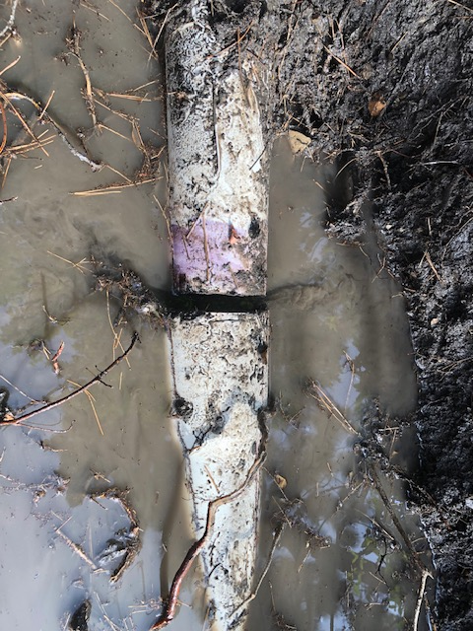
4” Drainage Line Repair
Repaired leak in 4” dia drain line on 16 Cinnamon back yard
Land movement pulled joint apart
Problem: It took 3 days to notify the right people with the right location to fix the pipe
Solution:
Add sign to PBCA entrances with Emergency Phone Numbers for ACLAD and PBCA
Blast email with a map of ACLAD drain lines and who to call if you discover a leak
Look into auto text or phone message to ACLAD and PBCA board members
What should you do if you see a leak in a white PVC pipe
Check your meter to make sure it’s not your irrigation system
Buy a FLUME
Call or text Gordon Leon 310-463-9244 and/ or Claudia Gutierrez 310-872-4874
Take a picture and Drop a pin on you phone and text it to us

Slide 3
Water Level Meter
Receive Eno Water sounder
Tried it on Well#10 sounding tube and 8” well casing
Only works with sounding tube
Added thin wall ½” tube down well #6 and it worked great
Able to watch water draw down to optimize pump timer
Cost $1474 for Eno Sounder and aprox $15 per well + labor.
Need motion to authorize $1474 + ~ $200 for sounder tubing

Slide 4
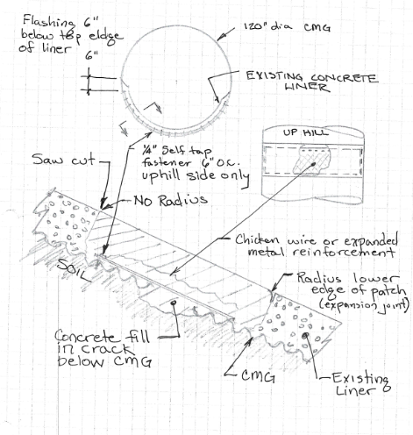
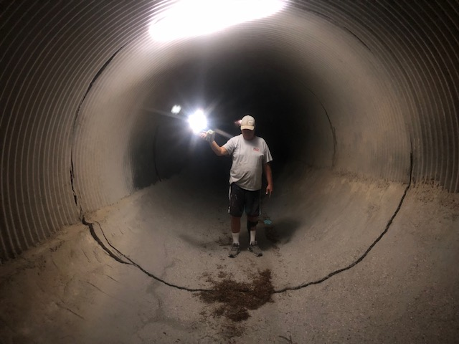
Cracks in PVDS Culvert
PVDS Culvert Repair
City council to authorize funding on Nov 14
Will start soon after Nov 14
Developed design for expansion joint with rapid implementation
Contractor on board
Reviewed by Hout Engineering
Suggested adding new culver inside existing or fiberglass culvert insert
Agreed that this could not be done prior to the rains
Approved our design as a near term fix
Need motion to authorize ACLAD funding, city willing to pay fair share ($10K)

